Slide 1
Traffic Collisions: Montgomery County Dataset Analysis

Slide 2
Agenda
Meet the team
Project introduction/ Project objective
Dataset Descriptions
Data Architecture
Non-Motorists Insights
Incidents Insights
Summary and Future Work
Drivers Insights

Slide 3
The Team (Group I)
Aasim Inamdar (x23236108)
Waleed Bin Umer (x23187956)
Sana Shafiq Jalgaonkar (x22237941)

Slide 4
Introduction
Traffic Safety is one of the global problem affecting the communities worldwide. Millions of people are impacted by road accidents every year, which leads to serious injuries, casualties and financial expenses.
The Automated Crash Reporting System (ACRS) is one of the ways by which Montgomery county, Maryland, is addressing the global topic of traffic safety.
The ACRS tracks and maintain the details on traffic crashes- including information about incidents, drivers and non-motorists.
This project aims to integrate the main 3 datasets from the ACRS: Crash Reporting: Non-Motorists Data, Crash Reporting: Incidents Data, and Crash Reporting: Drivers Data to perform a detailed analysis on the traffic safety of Montgomery county.
All the 3 datasets are provided on the official site of Montgomery count: https://data.montgomerycountymd.gov/

Slide 5
Project Overview
The main objective of the project is to integrate data from Crash Reporting: Non-Motorists Data, Crash Reporting: Incidents Data, and Crash Reporting: Drivers Data datasets using an Extract, Transform Load method via use of API and file formats.
To analyze these datasets to identify key insights of the data that are associated with the traffic crashes in the Montgomery county.
To provide the practical analysis and suggestions to public safety agencies to reduce the possibility that incidents of the same nature may happen again.

Slide 6
Datasets Description
The datasets used captures the details of all the traffic collisions occurring within the county of Montgomery which is collected with the help of Automated Crash Reporting System (ACRS) of the Maryland state police and reported by Montgomery County Police, Gaithersburg Police, Rockville Police, or the Maryland-National Capital Park Police :
Drivers' dataset keeps the track of each collisions recorded alongside the drivers involved in the incidents. It comprises of total 172K number of rows and 43 columns. Link to dataset- https://data.montgomerycountymd.gov/Public-Safety/Crash-Reporting-Drivers-Data/mmzv-x632/about_data
Incidents dataset provide the in general information about each collision with detail of all traffic collisions occurring on county and local roadways within the county. Link to dataset- https://data.montgomerycountymd.gov/Public-Safety/Crash-Reporting-Incidents-Data/bhju-22kf/about_data . As for the Incidents dataset, it had 97.5K rows and 44 columns.
Non-Motorists datasets records the information about the pedestrians and cyclists involved in the traffic collisions occurring on the county and local roadways with 5650 number of rows and 32 features. Link to dataset- https://data.montgomerycountymd.gov/Public-Safety/Crash-Reporting-Non-Motorists-Data/n7fk-dce5/about_data

Slide 7
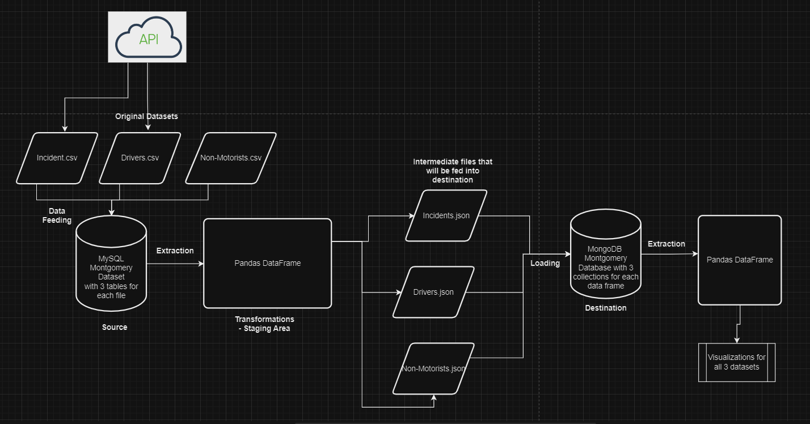
Data Architecture

Slide 8
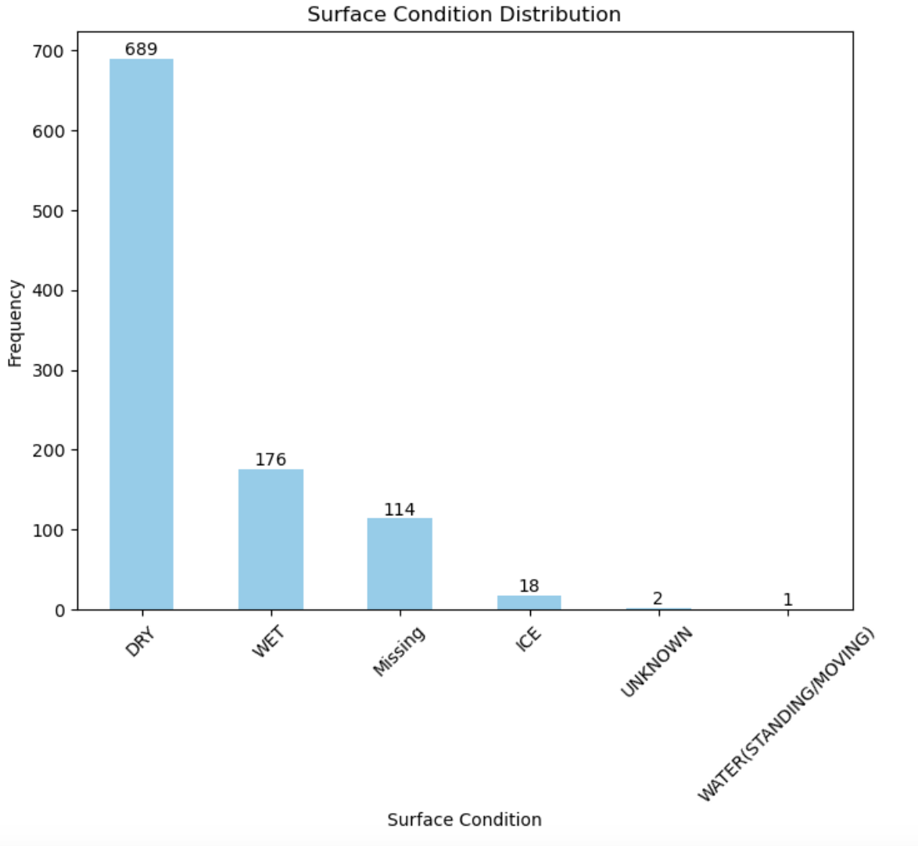
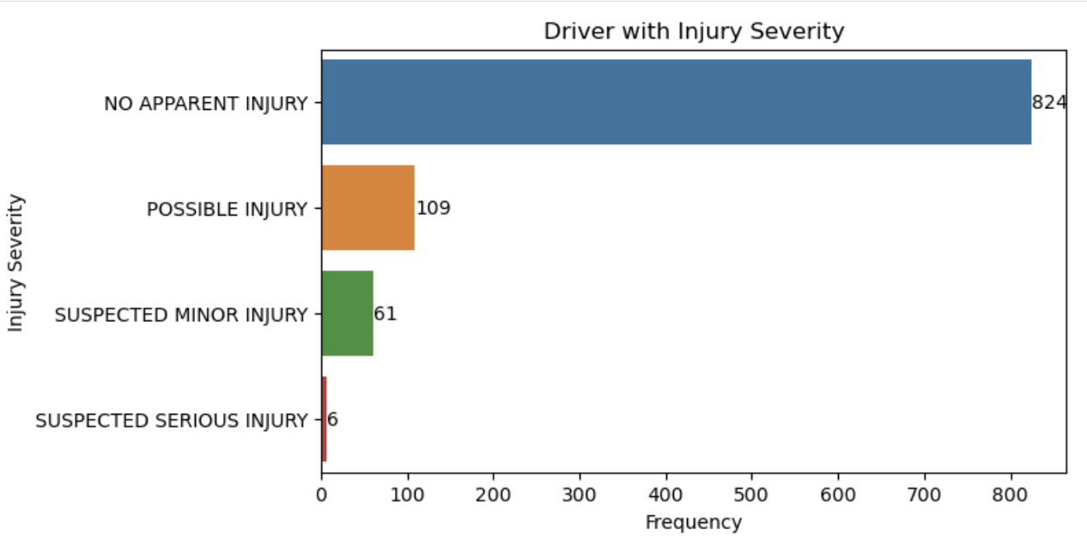
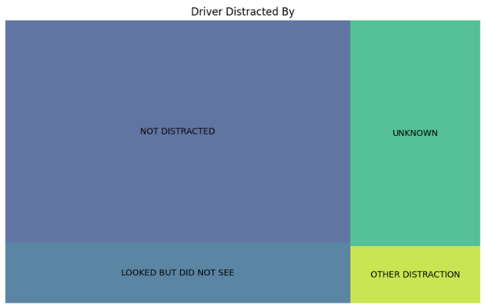
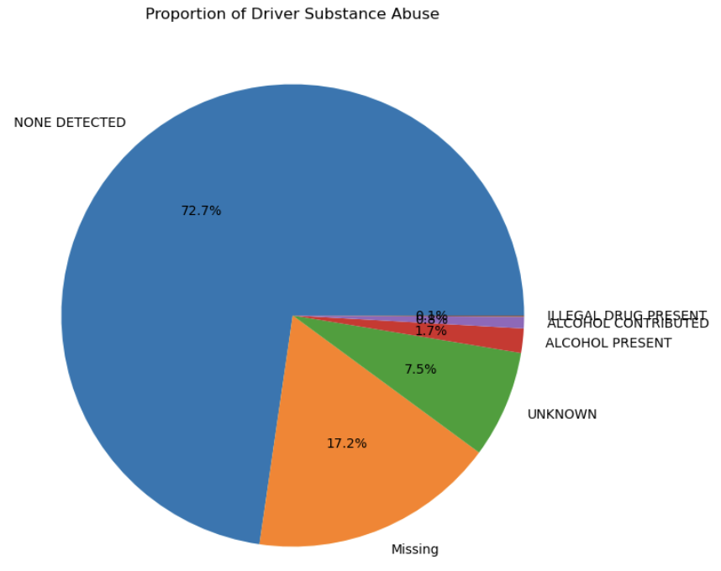
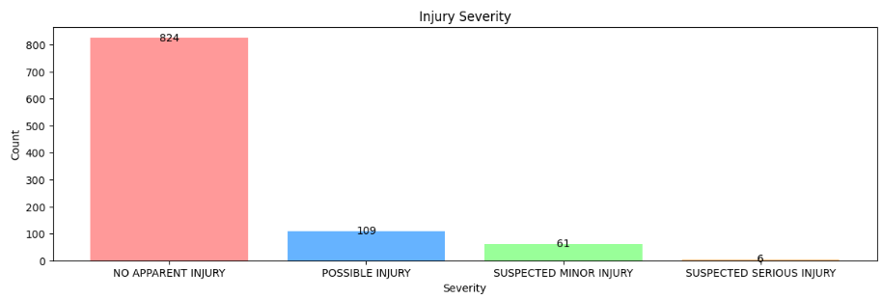
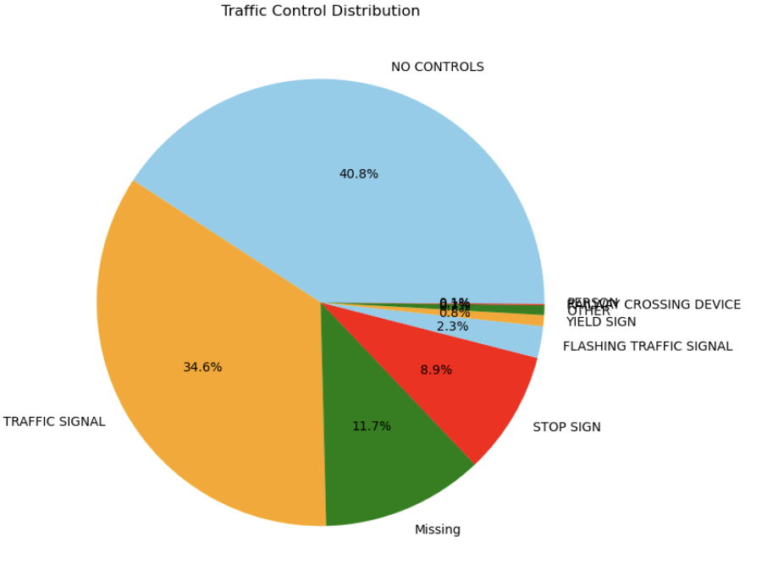
Drivers Insights

Slide 9
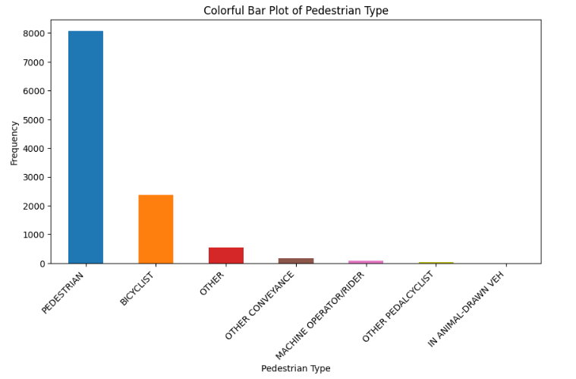
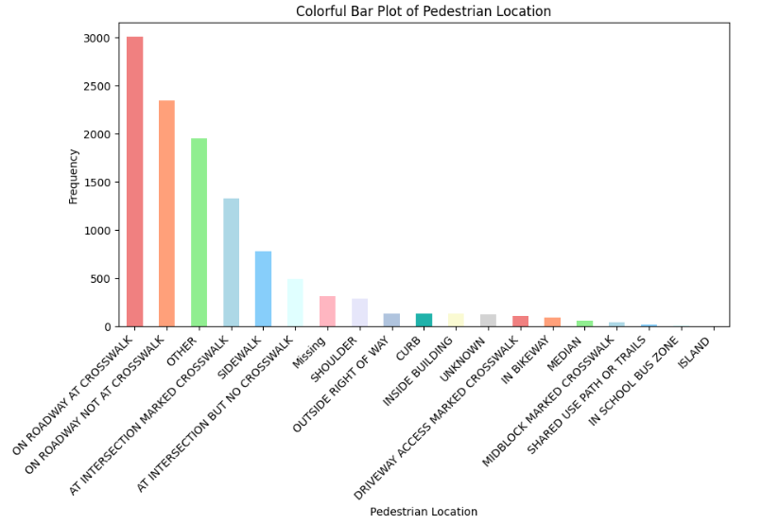
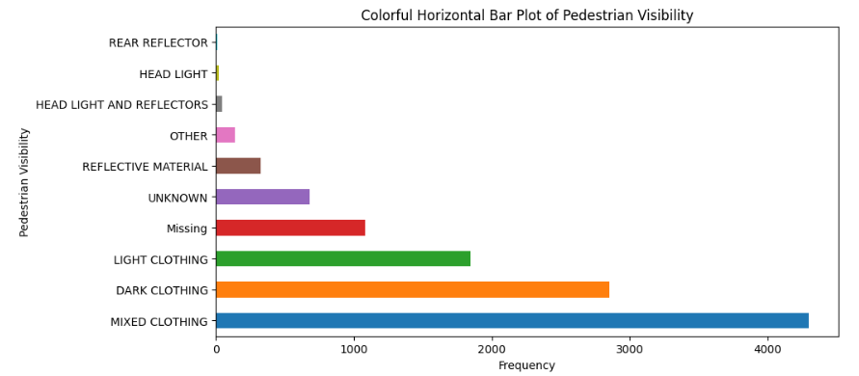
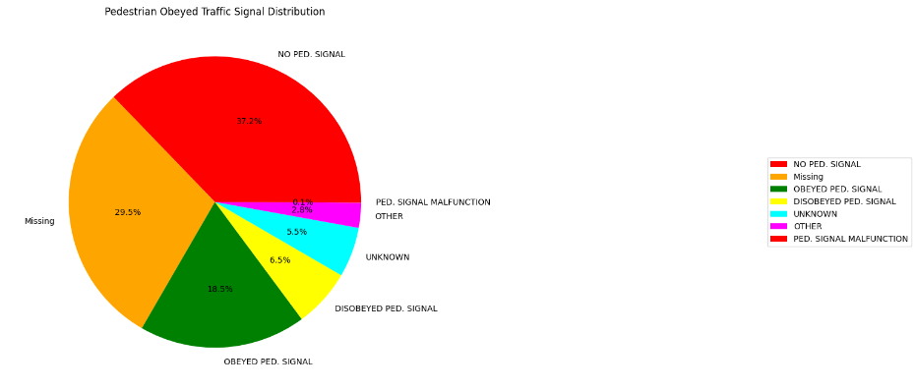
Non-Motorists Insights

Slide 10
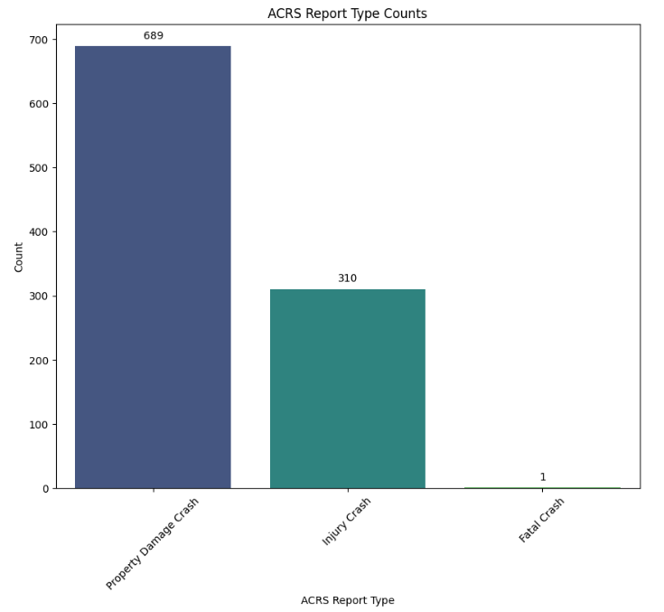
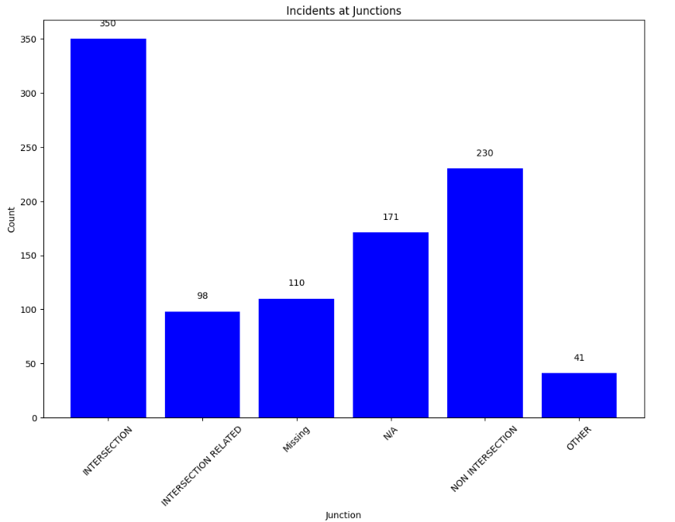
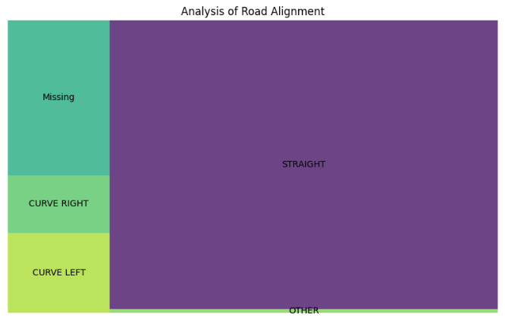
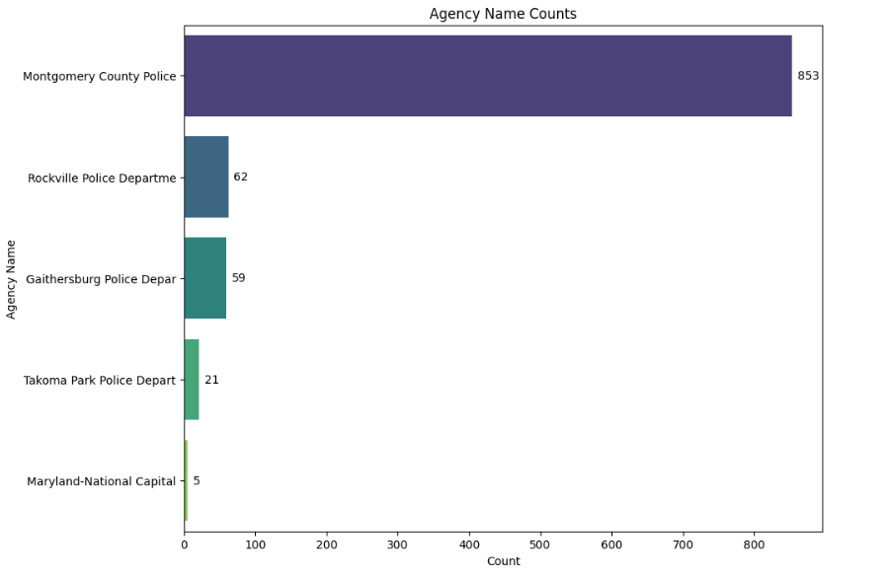
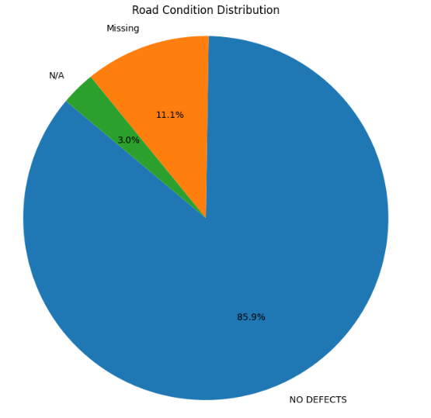
Incidents Insights

Slide 11
Summary
In most of the cases it was drivers’ fault, which was the cause of the incident, pointing out the importance of targeted measures to be taken into action like improving trainings of driving, enhancing traffic laws, and setting up the Advance Drivers Assistance System (ADAS) to reduce human errors on road.
Even though improper use of any equipment is not the common cause of the accident, the lack of detailed data on this feature points out how important it is to improve functionality of ACRS to track such features.
Effective road planning and safety precautions are challenged by the lack of data on road characteristics and driver behavior like distraction, despite high count of incidents at crosswalks.
Future studies should be more focused on developing new procedures and techniques for complete data collection and revised analysis with the goal of making rational choices for traffic control and road planning design.
Future research should concentrate on using new technologies like Artificial Intelligence to improve the accuracy of handling such collisions data collection and analysis which will contribute to developing evidence-based methods for reducing the frequency of such collisions in future.

Slide 12
Thank you
Group I
x22237941@student.ncirl.ie
x23236108@student.ncirl.ie
x23187956@student.ncirl.ie

